Slide 1


CUSTOMER SATISFACTION

Slide 2

What is Customer Satisfaction?
Customers Expectations and Confidence
Service Quality
Understanding Customers

Slide 3

1. What is Customer Satisfaction
perceives
effectively provided
Customer Individual/Firm/Organization Product/Service
Customer is aware/use the product/service
meets the needs

Slide 4

2. Customers Expectations and Confidence
Expectations > What customers think they received = High quality of service/product
Expectations based on:
Word of mouth
News stories
Marketing efforts
Advertising
New technologies
Service innovation
Social trends
A successful company is able to meet expectations in every step.

Slide 5

3. Service Quality
Service (intangible offer)
+
Quality (characteristics of product or service that satisfy needs)
=
Service Quality (meet or exceed expectations)

Slide 6




4. Understanding Customers
Conduct Research →Relationship with customers → Loyal Customers
Customers Satisfaction Measurement allows an organization to:
Focus its time and resources more effectively
Understand what it can and cannot control
Focus on its customers

Slide 7



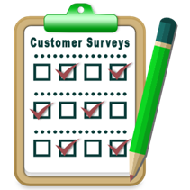

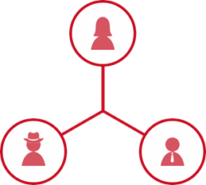
Steps in measuring and managing customers satisfaction
Improve your processes
Focus on priorities
Measure your customers service performance
Understand your customer’s needs
Know who your customers are

Slide 8




The results will impact:
Customer satisfaction
Business plans
Performance measurement
Employee relations
Marketing plans

Slide 9

Thank you!
Student Name: Roxana Lazar
Course Code: DT596/2
Tutor: Andrew Horan

